Slide 1
SOFTWARE PROJECT MANAGEMENT

Slide 2


Software Project Planning

Slide 3
Software Project Planning (Recap)
Monitoring Execution & Control
Initiation and approval of the project typically happens at the end of the Feasibility study
Planning is one of the first tasks in the project where the Project Manager focusses on what needs to be achieved and how.
Planning involves looking ahead and making provisions for the required resources so that the project will be executed smoothly without surprises
The outcome of the planning phase would typically be a Project Plan
The level of this project plan would depend on the nature of the project whether it is a exploratory, research or development etc.
The project plan can evolves over the lifecycle of the project based on the progress achieved, changes in context, risks encountered or any unforeseen changes.

Slide 4
A Project plan needs to answer questions from
Sponsors Perspective like
Where does this product/project fit strategically to the vision/roadmap of the organization
What is the investment (Budget) / Revenue expected (Predicted)
How long will this take to build and what are the risks
Who is responsible and how is the progress tracked
What resources are required and what are the deliverables
How will we say that the project is Complete/successful/has met exit criteria.
Customer perspective
Does the team working on the product/project understand the problem
How long will it take, how much will it cost
Criteria for accepting the product/project to be complete and meeting expectations

Slide 5
Project plan needs to answer questions from -
Execution Stakeholders perspective
What Lifecycle are we going to follow
Criteria for prioritizing of requirements
Project Organization:
Relationships to other parts of the organization (Upstream/Downstream)
Roles of people
User involvement
Standards-Guidelines-Procedures to be followed
Communication Mechanisms
Schedule with Detailed Work Breakdown and Ownership

Slide 6
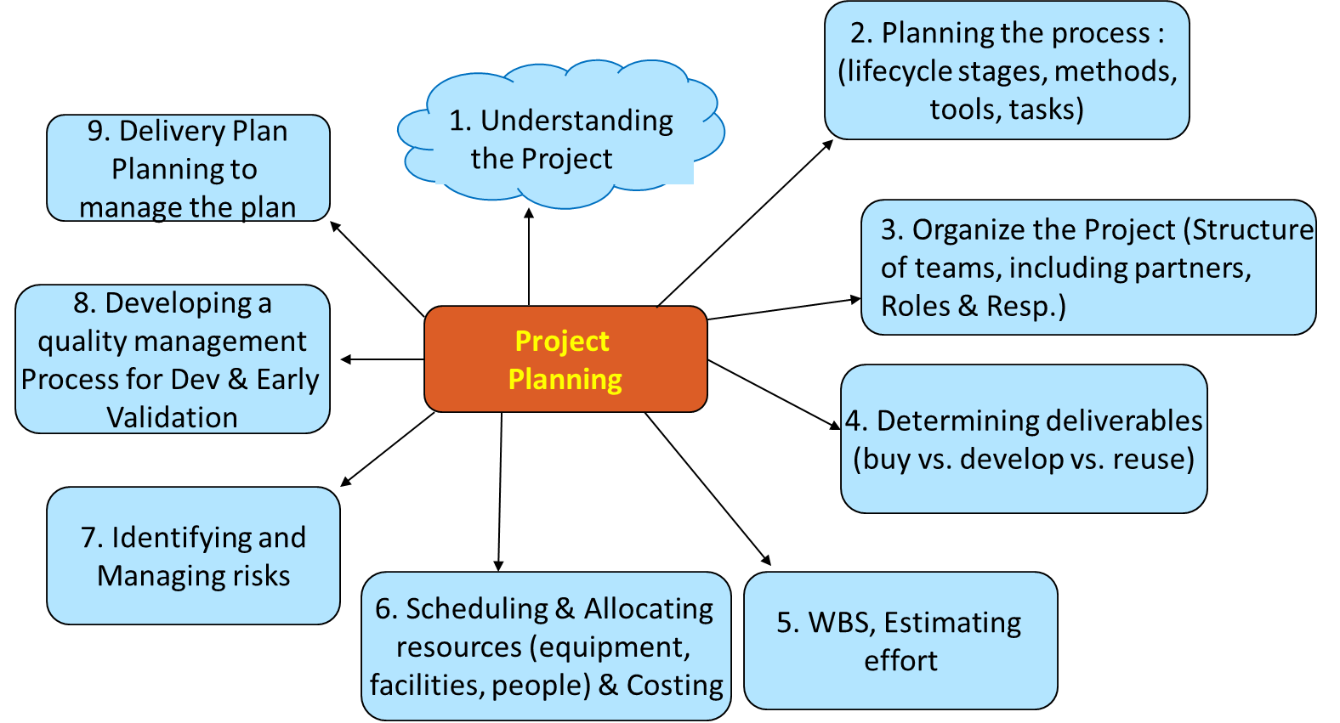
Project planning process (Recap)

Slide 7

Software Project Planning Steps
Understanding the expected deliverables of the project
Expectations of customers, stakeholders in terms of the deliverables
The market forces driving the project (technology/ competition etc.)
Looking at the high level decisions of Make-Buy-Reuse
This is typically supported by the results of the feasibility study and the requirements elicited.

Slide 8
Software Project Planning Steps
Planning the process
Choice of the lifecycle can be based on
Generics on project/product characteristics which can be used to help on the choice of the lifecycle in terms of the activities, goals, time boundedness, inter-related activities and constraints on scope, time and other resources
We can also characterize it based on the degree of certainty as High or Low of
Product
Process
Resource

Slide 9
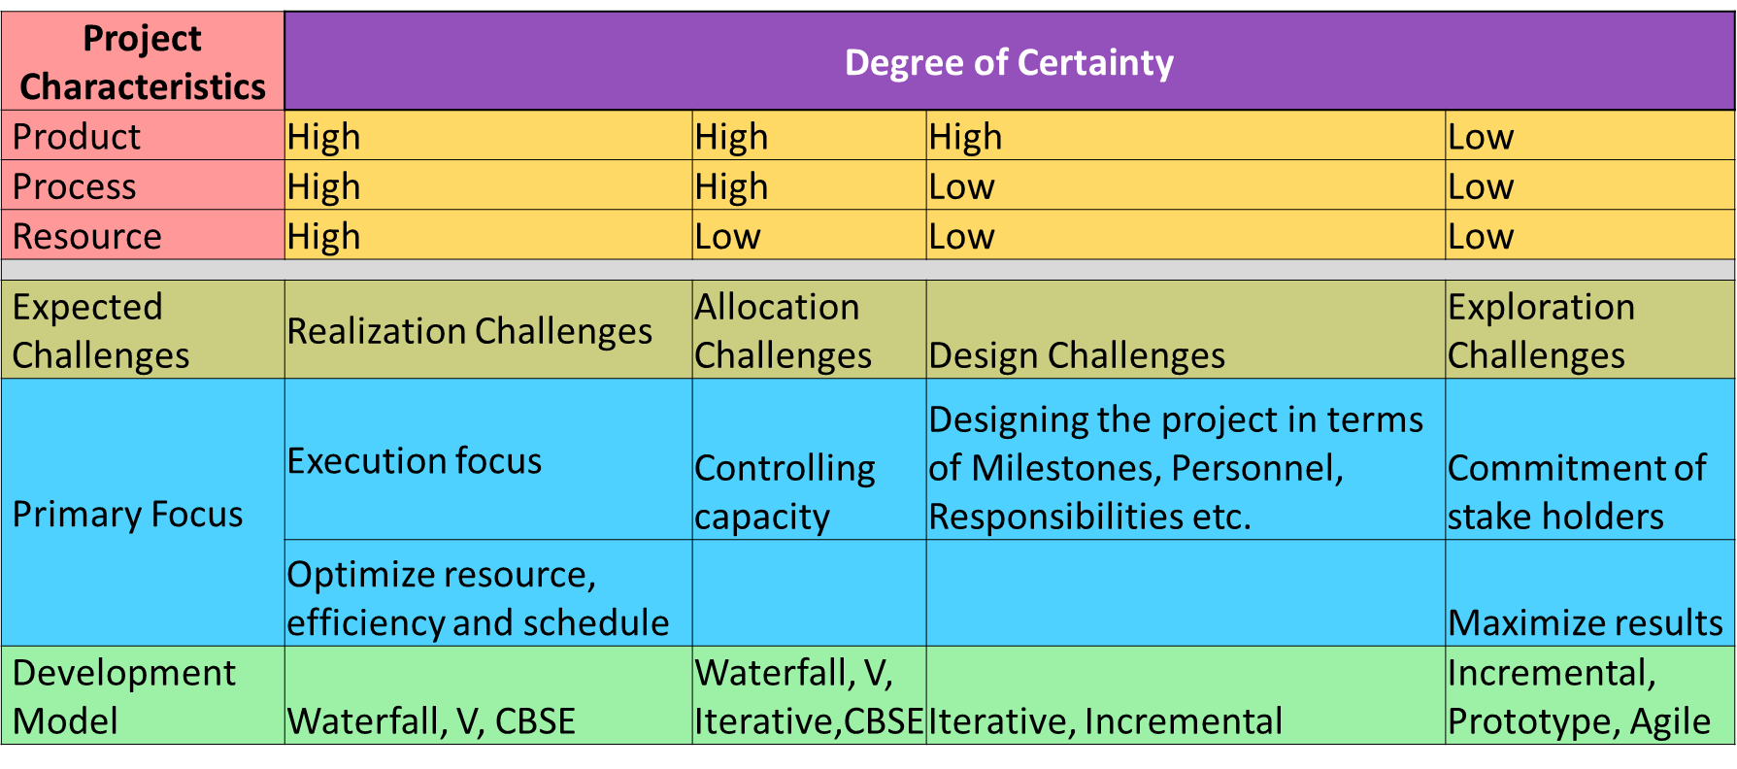
Software Project Planning Steps

Slide 10
Software Project Planning Steps
Models, Standards, guidelines, procedures
What processes model and procedures are to be followed?
What standards should this conform to? Technical, Interoperability, Quality, Regulatory etc.
Configuration Management, Change management, Quality Plans
Identifying the tools that needs to be used through the lifecycle

Slide 11
Software Project Planning Steps
Organize the project
Structure:
Organizational Structure in terms of people, team, responsibilities E.g. Project Manager, Programmer, Architects, Engineers etc.
Context of Hierarchical, Flat, Functional, Matrix, Line Organizations
Partners :
Identification of eco-system partners for the project Build, Install, Localization, Documentation, Product Management, Product marketing, Sales, Pre-Sales, Support etc.
Relationship of Partners – Upstream and Downstream

Slide 12
Software Project Planning Steps
Determining Deliverables
Buy vs. Develop vs. Reuse
WBS
Typically its an iterative process
Considering the requirements and in discussion with a few key team members, Split project into Level 1 - Tasks/Activities or subprojects
Decompose these into more detailed tasks/ Activities (Level 2) … and do this till you believe you have enough granularity in the tasks which can be meaningfully tracked
This hierarchical tree structure is called Work breakdown structure or WBS

Slide 13
Software Project Planning Steps
WBS (Cont.)
Aggregate these tasks into Phases
Identification of Milestones/Checkpoints/ Toll Gates for these Phases/Tasks
Entry Criteria & Exit criteria for the phases/ milestones/ check points
Identification of Work Packages for final product
Estimation of the Tasks/Activities (effort and time)
Estimation is typically done for effort needed for executing each of the tasks in the WBS
WBS itself is an estimation of all the tasks involved in the project, there can be estimate for cost ..etc.
Estimation can be done top down or bottoms up

Slide 14
Software Estimation approaches
Estimation could be
Experience based like based Delphi, Modified Delphi, Expert judgement, comparative studies
Formal techniques based like the formula based CoCoMo for project effort, where the formula is based on historical estimates of product attributes, such as size, and process characteristics and experience of staff involved E.g.
In CoCoMo (Constructive Cost Model), projects are categorized into organic, embedded and semi detached.
Organic : Team size is small, problem is well understood, people have experience of solving it earlier.
Embedded : Large team size, complex, need people with sufficient experience
Semi-detached : In between these two

Slide 15
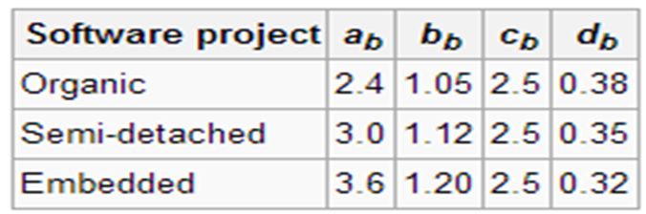
Estimation Approaches
and
Effort E = a_{b}(KLOC)^{b} Person months, Where
Similarly there is an formula for Schedule.
Types of CoCoMo models
Basic – for quick rough calculations
Intermediate takes cost drivers into consideration
Detailed in addition factors in dependencies

Slide 16
Software Project Planning Steps
Scheduling and allocating resources
Schedule is created using outcomes of WBS & estimation, and is the calendarization of the work activities
Involves bringing all concerned individuals to participate in building this schedule
Identification and allocation of the resources to the broken down project activities (WBS).
Hardware, Software, Human
Rework on estimates and schedule based on their competencies/lack of competencies
Validation of upstream and downstream dependencies for these Tasks/Phases

Slide 17
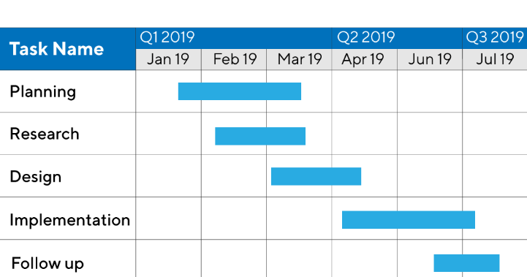
Software Project Planning Steps
Scheduling and allocating resources (Contd.)
Organizing tasks concurrently to make optimal use of people working on the project and sequentially to manage dependencies
Use of graphical tools like Gantt chart to visualize these
Identification of schedule risks and mitigation plans
Minimize task dependencies to avoid delays caused by one task waiting for another to complete
Taking care of working conditions such as holidays, work shifts, resource availability and so on
Involves multiple iterations of looking at Feature requirements- Schedule/Calendar - Resource/people and costs
Costing in terms of Budget, Capital and Expenses
Tools like the Microsoft project are used for scheduling
Gantt Chart

Slide 18
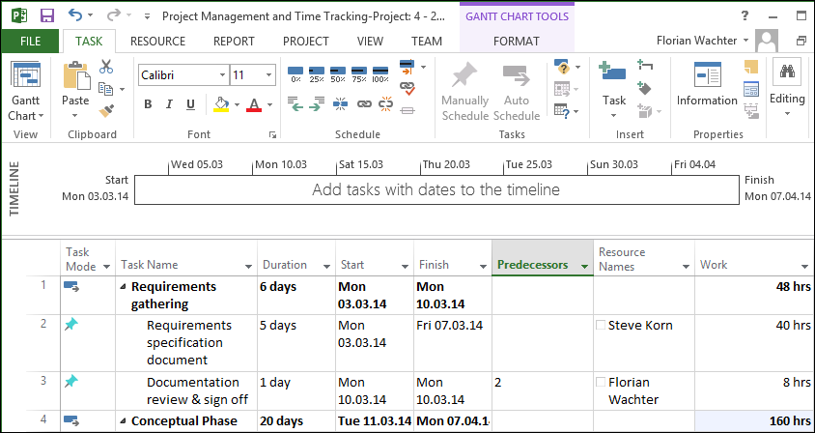
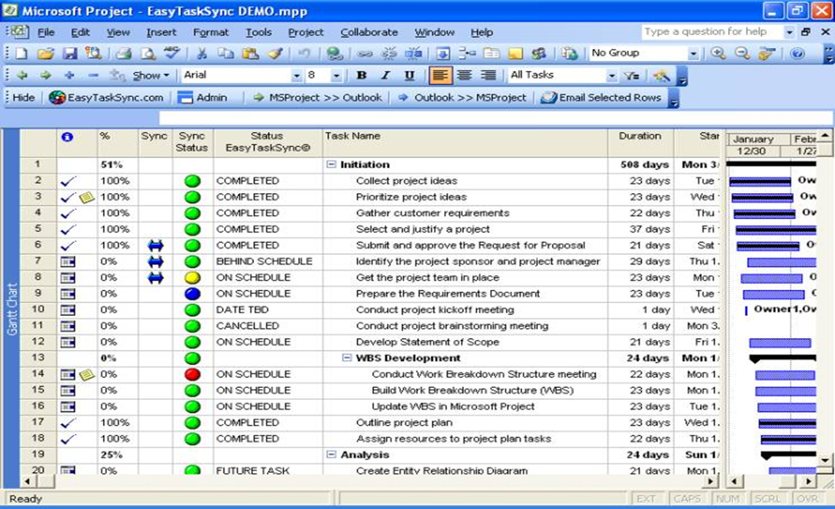
View of what you would see with a tool like Microsoft Project :
Gantt Chart .. WBS, Schedule, Dependencies etc

Slide 19
Software Project Planning Steps
Identifying and Managing risks
Risk is any unexpected event that might affect the people, processes, technology, and resources involved.
Risk Management can be for Products, Projects, Organizations etc.

Slide 20
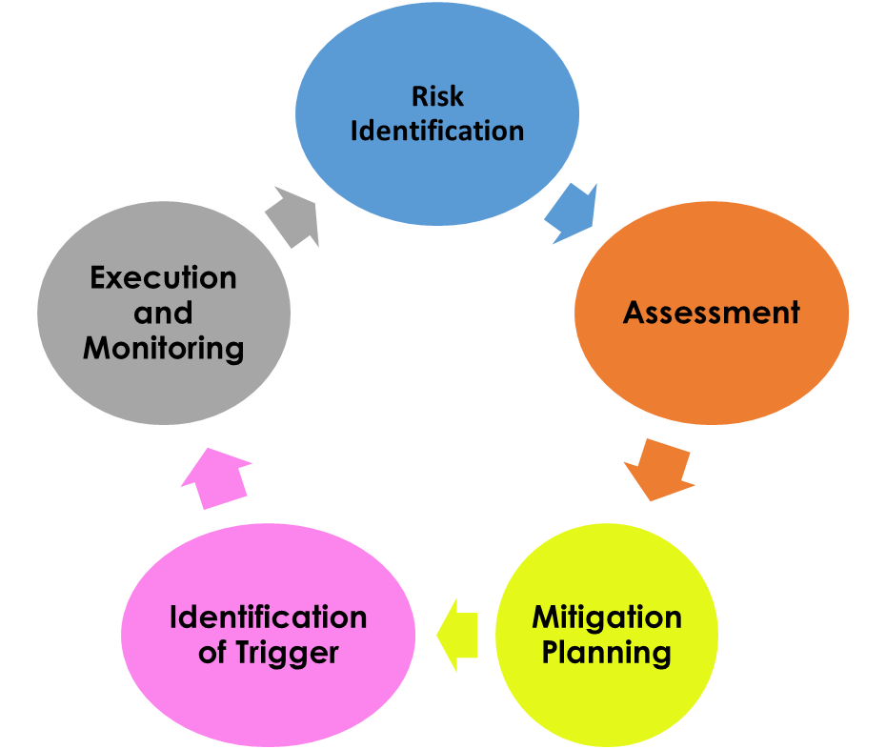
Software Project Planning Steps
Steps involved in Risk Management
Identification of the Risk (what might go wrong)
Assessment and analysis (assessment of probability of occurrence and impact)
Mitigation/Fall back planning (what can we do about it? What might we have to do)
Identification and Catching the Trigger (how will we know the risk has happened)
Execution and monitoring of the Mitigation Plan
Mitigation Planning

Slide 21
Software Project Planning Steps
Developing a quality management process
Plans for Tracking of the projects/product progress
Communication plans (Verbal/Written)
Quality assurance plans (including all processes planned
Test Completion criteria’s
Early verification or Customer validation e.g. Beta

Slide 22
Software Project Planning Steps
Plans for tracking Project Plan & Delivery plan
Plans for Managing the Project Plan
Procedures to be followed to release the product to customer
Independently there would be activities towards
Staffing and people engagement/ performance management activities
Compensation and Benefits management

Slide 23
Outcome & Role
The out come of the list of activities done as part of the planning would be
Project Plan
Work Breakdown – List of Tasks in a granular form
Schedule – Calendarized plan for implementation and delivery
Resource Management – Allocation, Balancing of workload, orchestration for parallelism/sequencing for efficiency and dependency management, defining of roles and responsibilities
Plans for communication, metrics, checkpoints, criteria’s for completion etc.
Risk management Plan, Quality Plan – SQA ..
Roles in Project Management
Project Manager .. Different levels
Program Management ..

